Slide 1
Data Essentials L3
Module 2: From Data to Insight

Slide 2
Knowledge (1 of 2)
KSBs
K3₁ How to collate and format data in line with industry standards.
K4₂ Data formats and their importance for analysis. Management and presentation tools to visualise and review the characteristics of data. Communication tools and technologies for collaborative working.
K6₁₊₂ The value of data to the business. How to undertake blending of data from multiple sources.
Subscript = Assessment method
1: 'Scenario Demonstrations with Questioning'
2: 'Professional Discussion Underpinned by a Portfolio'
Notes:
There are now a large number of KSBs associated with this module. The learners may find it daunting (and perhaps boring) if the learner goes through them all right at the start of Day 1.
Alternatively, the tutor could mention KSBs a few at a time on a per-activity basis. If this method turns out to work best then we can delete these KSB intro slides in a future version of these slides.

Slide 3
Knowledge (2 of 2)
KSBs
K8₁ How to filter details, focusing on information relevant to the data project.
K9₁ Basic statistical methods and simple data modelling to extract relevant data and normalise unstructured data.
K10₂ The range of common data quality issues that can arise e.g. misclassification, duplicate entries, spelling errors, obsolete data, compliance issues and interpretation/ translation of meaning.
Subscript = Assessment method
1: 'Scenario Demonstrations with Questioning'
2: 'Professional Discussion Underpinned by a Portfolio'

Slide 4
Skills (1 of 2)
KSBs
S2₁ Collect, format, and save datasets.
S3₁ Summarise and explain gathered data.
S4₁ Blend data sets from multiple sources and present in format appropriate to the task.
S5₁ Manipulate and link different data sets as required.
Subscript = Assessment method
1: 'Scenario Demonstrations with Questioning'
2: 'Professional Discussion Underpinned by a Portfolio'

Slide 5
Skills (2 of 2)
KSBs
S6₁ Use tools and techniques to identify trends and patterns in data.
S10₂ Demonstrate the different ways of communicating meaning from data in line with audience requirements.
S13₂ Explain data and results to different audiences in a way that aids understanding.
S17₂ Operate as part of a multi-functional team.
Subscript = Assessment method
1: 'Scenario Demonstrations with Questioning'
2: 'Professional Discussion Underpinned by a Portfolio'

Slide 6
Distinction criteria
KSBs
D2₁ Justifies why we undertake crosschecking of data.
D7₂ Evaluates why we need to store, manage, and distribute data, and justifies the importance of maintaining ethical and security standards.
Subscript = Assessment method
1: 'Scenario Demonstrations with Questioning'
2: 'Professional Discussion Underpinned by a Portfolio'

Slide 7

DAY 1
Schedule
AM
Types of data file
Formatting data
PM
Filtering data
Formulas and functions

Slide 8
DAY 2
Schedule
AM
Lookup functions
Joining tables
PM
Joining tables (cont’d)

Slide 9
DAY 3
Schedule
Power Query

Slide 10
Day 1

Slide 11
Types of data file

Slide 12
KSBs
Types of Data File
K4₂ Data formats and their importance for analysis. Management and presentation tools to visualise and review the characteristics of data. Communication tools and technologies for collaborative working.

Slide 13


a,b,c
x,y,z
Common types of data file
CSV
XLSX
JSON
Notes:
Learners will probably all have seen CSV and XLSX files before. JSON will be less familiar.
While all three file types were covered in the Online phase, extra recap may be required.

Slide 14
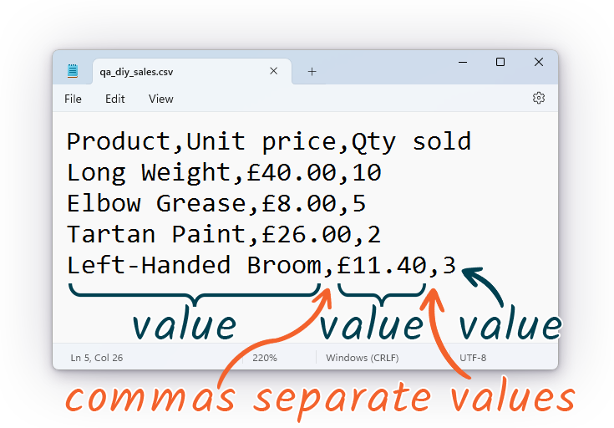
CSV: Comma-separated values
CSV format
Notes:
Key facts:
CSV is a plaint-text format, suitable for storing unformatted numbers and text. (No font, colour, etc.)
Since it is a text file, the CSV file contains no embedded metadata. (Unlike, e.g., a JPEG, MP3, or Microsoft Office file.)
The delimiter character is the comma.

Slide 15
CSV: Comma-separated values
Knowledge check: CSV files
Question 1
What type of file is a CSV file?
A: Image file
B: Plain-text file
C: Zip archive
D: Executable file
✔: Excel file (same as XLSX)
✘: It’s a trick question
Notes:
A: B – Plain-text file.
If any learners think the CSV format is the same as the XLSX format, it is probably worth pausing to recap the significant differences between the two.

Slide 16
CSV: Comma-separated values
Knowledge check: CSV files
Question 2
What is the usual delimiter (separator) character in a CSV file?
A: Tab
B: Colon :
C: Space
D: Comma ,
✔: Double-quote '
✘: Pipe |
Notes:
A: D – Comma.
Answer at the top of the slide!

Slide 17
CSV: Comma-separated values
Knowledge check: CSV files
Question 3
If we open a CSV file directly in Excel, what potentially unwanted transformations(s) could occur?
A: Number rounding
B: Date-like strings converted to dates
C: Corrupted text due to character encoding, e.g., Â£ instead of £
D: All of the above
Notes:
A: D – All of the above.
The tutor may wish to demonstrate by creating a CSV file in Notepad and showing that e.g. '5 jun' becomes 05/06/<current year>, and 000.12345678901234567890 becomes 0.123456789012345. This is data corruption!
(If anyone is interested: £ becomes Â£ due to differences between the UTF-8 and Windows-1252 character encodings. Rule of thumb: if we see odd symbols we didn’t expect, we should think 'character encoding mismatch'. At least one learner has failed EPA because of this problem.)
Follow-up Q: How can we open a CSV file in Excel with no danger of this kind of data corruption?
A: Power Query.

Slide 18
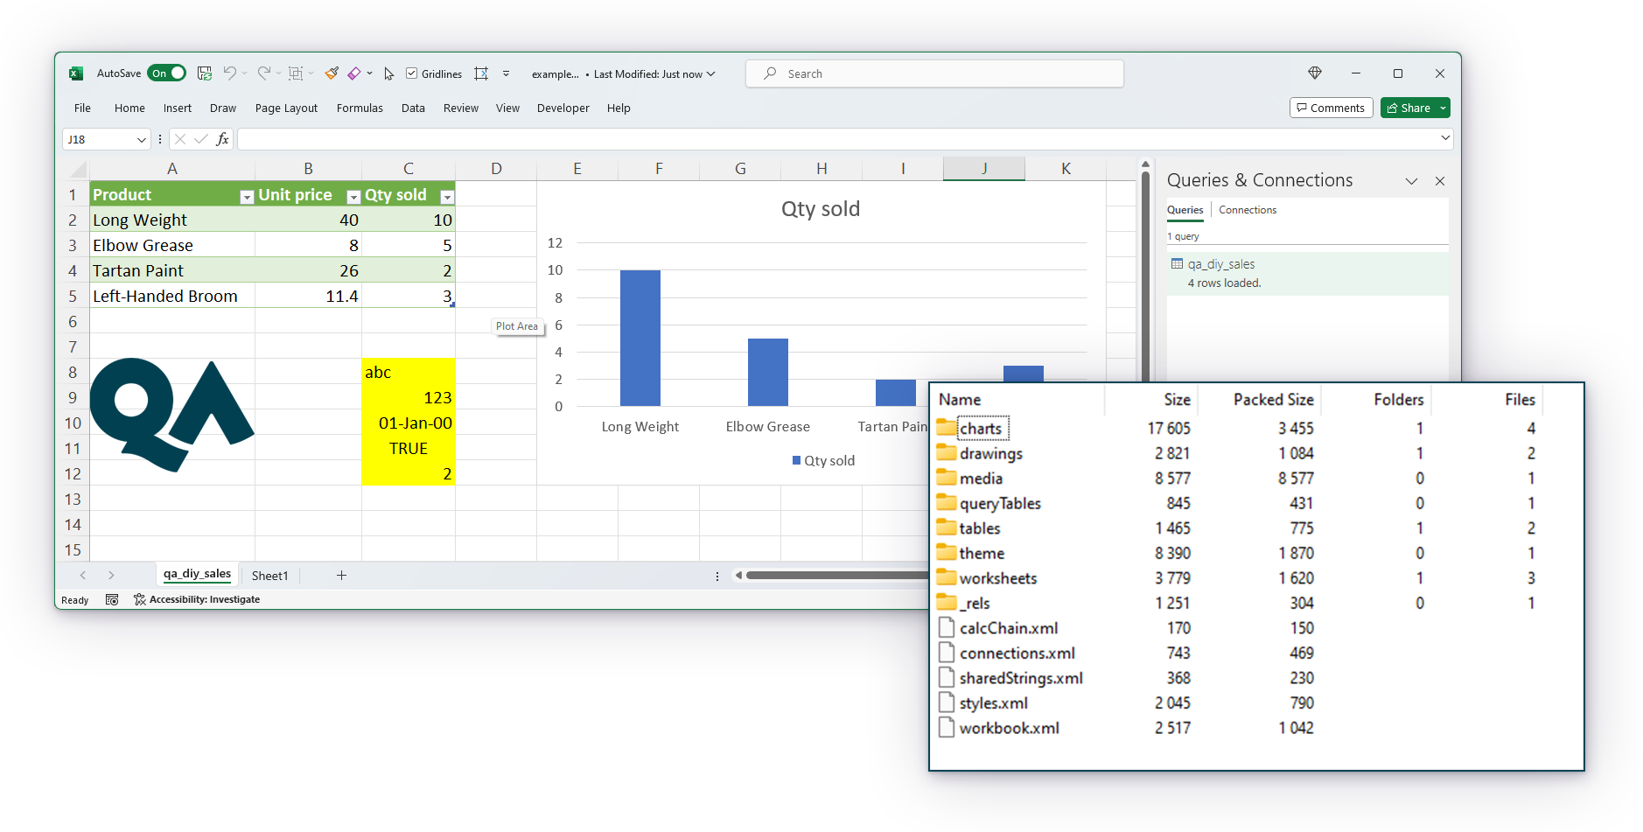

XLSX: Open Office XML
XLSX format
Internally, an XLSX file is mostly a collection of XML files.
Notes:
The screenshot to the right shows the internal structure of an XLSX file.
Key facts:
XLSX is the native file format for Microsoft Excel workbooks. Excel can both read and write XLSX.
XLSX supports many types of content, including spreadsheets, charts, formulas, rich formatting, Tables, Named Ranges, images, and more.
Bonus facts (not essential to teach):
An XLSX file is a zip archive containing a collection of XML files in a folder structure. There may also be embedded image files.
XML files are plain-text file. Like JSON, XML can encode nested data structures. XML is more versatile but also more complex to read and write.
The tutor may wish to show an example of an XML file, but this is not essential. We will not be studying XML files in the apprenticeship.

Slide 19
XLSX: Open Office XML
Knowledge check: XLSX files
Question 1
Which Microsoft Office application natively supports the XLSX format?
A: Excel
B: PowerPoint
C: Word
D: All of the above
Notes:
A: A – Excel
(Hoping 100% of learners know this.)

Slide 20
XLSX: Open Office XML
Knowledge check: XLSX files
Question 2
Consider the XLSX, PPTX, and DOCX file formats.
Of these, the XLSX format is the most suitable for storing what type of content?
A: Documents
B: Slideshows
C: Spreadsheets
D: None of the above
Notes:
A: C – Spreadsheets
'Most suitable' is subjective but 99.9% of people should agree the answer is spreadsheets.

Slide 21
XLSX: Open Office XML
Knowledge check: XLSX files
Question 3
Which of these types of content cannot be stored in an XLSX file but can be stored in an XLSM file?
A: Music
B: Mathematical formulas
C: Macros
D: Movies
Notes:
A: C – Macros
Slightly tricky? This was mentioned in the Online content, but only once.

Slide 22
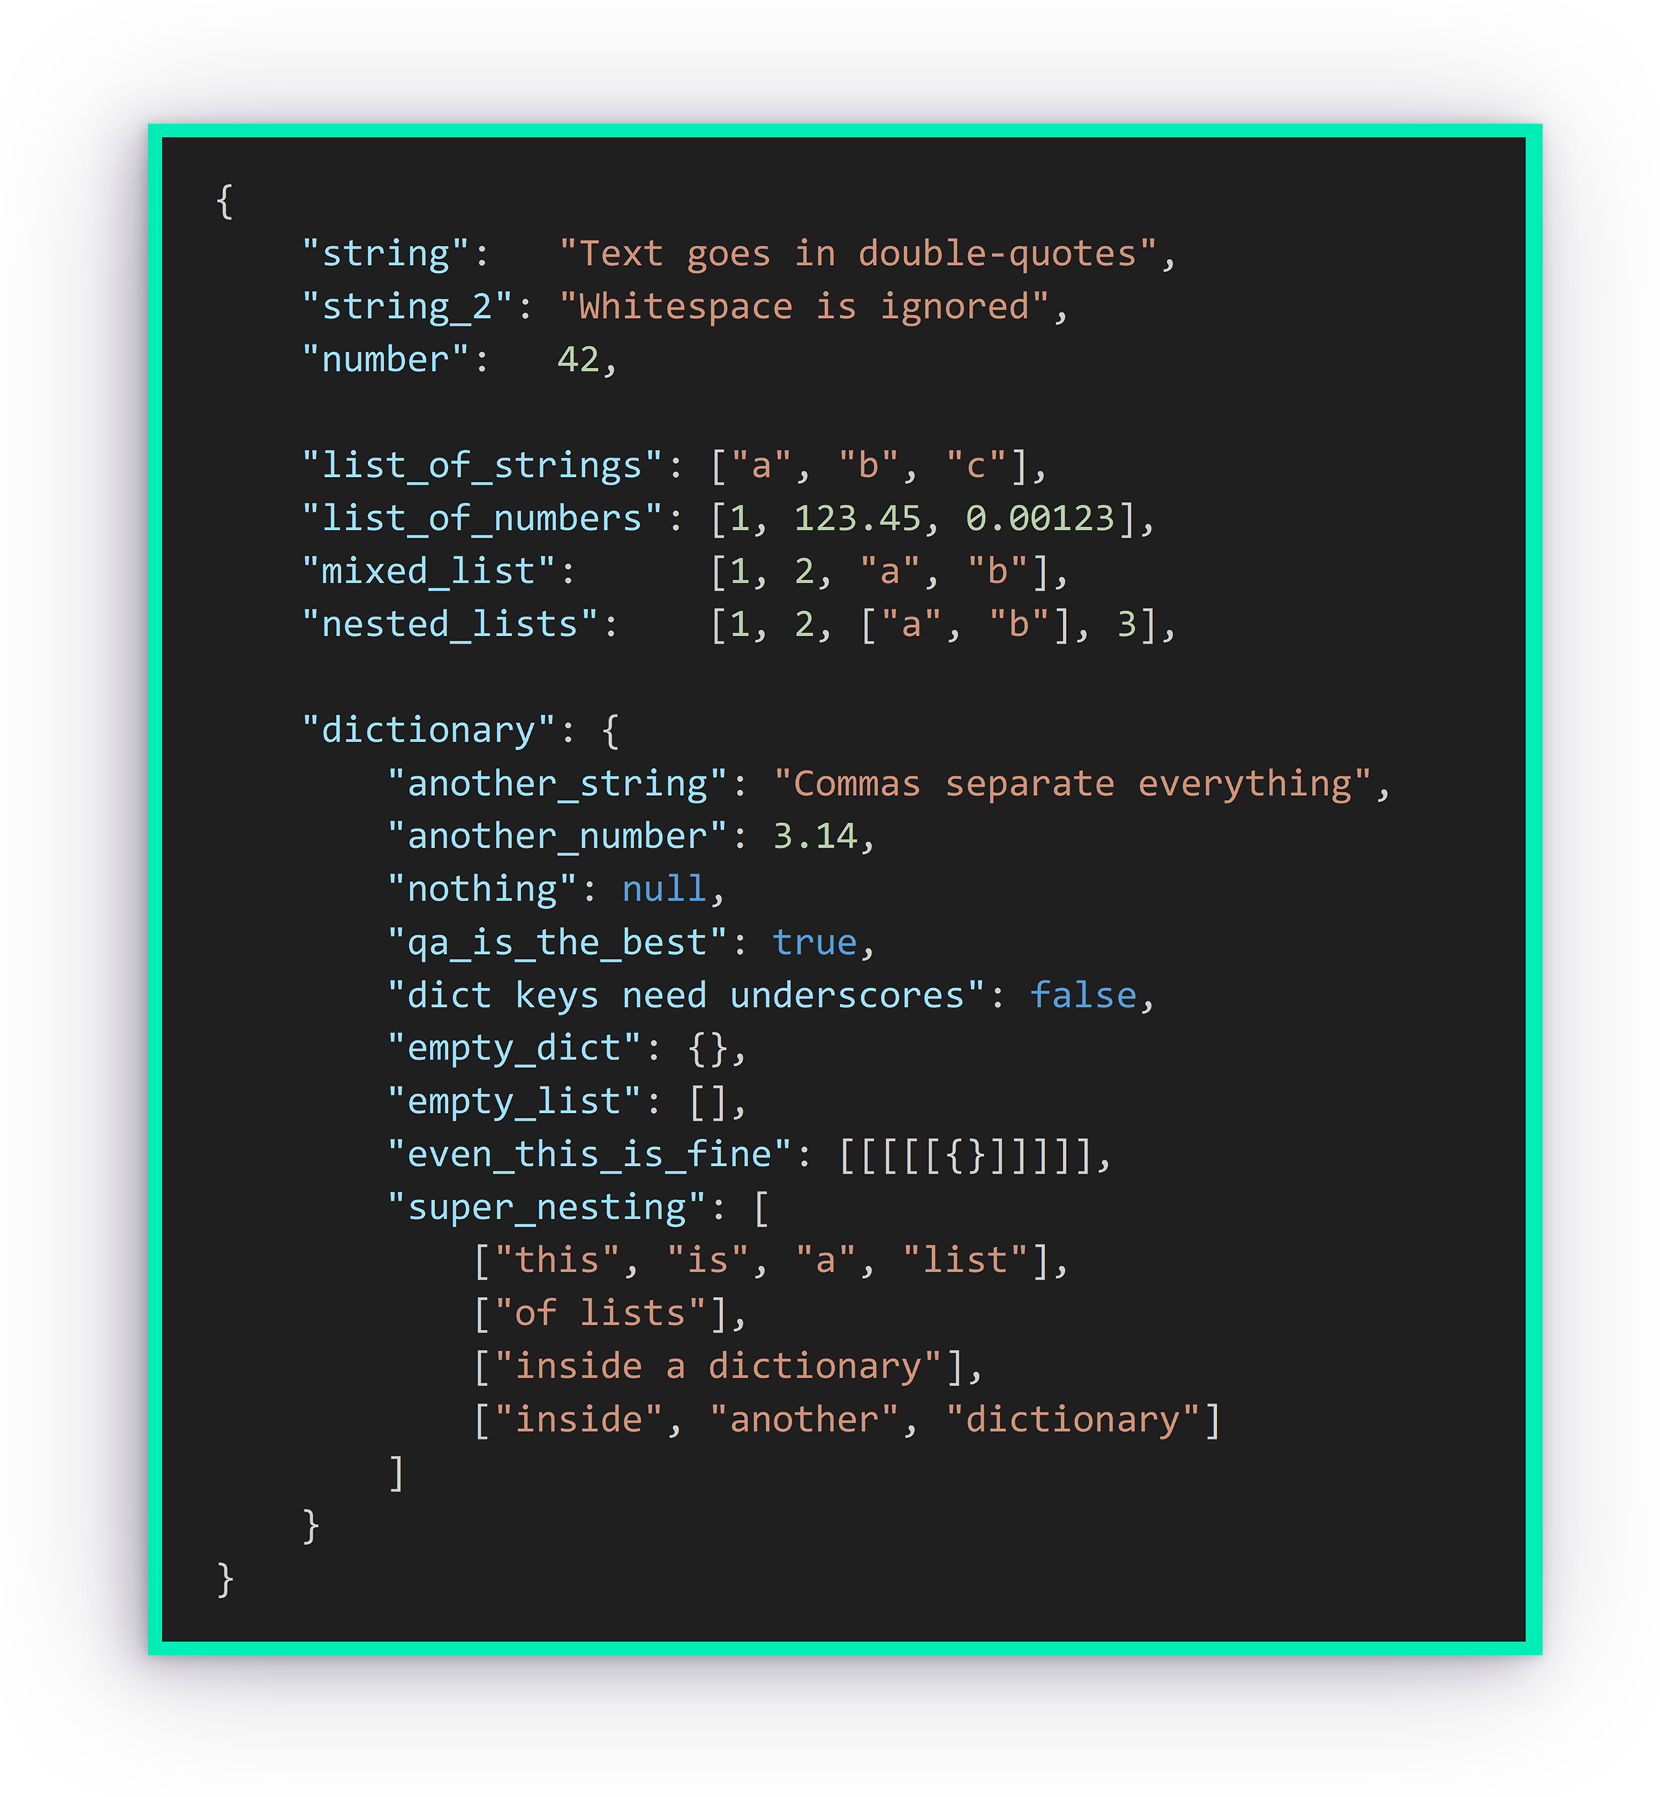
JSON: JavaScript Object Notation
JSON format
Notes:
Key facts:
JSON is a plaint-text format, suitable for storing unformatted numbers and text. (The coloured text seen in the screenshot is a cosmetic addition.)
Unlike CSV and XLSX, JSON can easily represent data with a non-tabular structure, such as a hierarchy or a branching tree.
JSON is a fairly common format for data files. It is very common for API call results.
The flexibility of the JSON format comes from the ability to nest lists and dictionaries within one another to arbitrary depth.
A JSON file can be opened in Excel using Power Query.
Example JSON file: https://www.gov.uk/bank-holidays.json.
Other notes:
In addition to numbers and text, JSON also supports the special values true, false, and null.
JSON files are usually generated programmatically, but it is possible to create one manually, e.g., using Notepad. Just remember to change the file extension from .txt to .json when you’re done.

Slide 23
JSON: JavaScript Object Notation
Knowledge check: JSON files
Question 1
What type of file is a JSON file?
A: Image file
B: Plain-text file
C: Zip archive
D: Executable JavaScript file
Notes:
A: B – Plain-text file

Slide 24
JSON: JavaScript Object Notation
Knowledge check: JSON files
Question 2
What types of collection are supported by the JSON standard?
A: Dictionaries and lists
B: Thesauruses and sets
C: Tables and cells
D: Files and folders
Notes:
A: A – Dictionaries and lists
If anyone asks:
Dictionary: a set of key-value pairs where every key must be unique. {'key1': 'value1', 'key2': 'value2', 'key3': 123.456}
List: an ordered array of unnamed values. ['value1', 'value2', 'value3', 1, 2, 3]
Thesaurus: not an actual collection type.
Set: like a list, but every value must be unique. Sets are typically unordered. Not used in JSON.

Slide 25
JSON: JavaScript Object Notation
Knowledge check: JSON files
Question 2
How can collections be nested in a JSON file?
A: Lists can go inside lists
B: Dictionaries can go inside dictionaries
C: Lists can go inside dictionaries
D: Dictionaries can go inside lists
✔: A and B only
✘: A, B, C, and D

Slide 26
Formatting data

Slide 27
KSBs
Formatting Data
K3₁ How to collate and format data in line with industry standards.
K4₂ Data formats and their importance for analysis. Management and presentation tools to visualise and review the characteristics of data. Communication tools and technologies for collaborative working.
K10₂ The range of common data quality issues that can arise e.g. misclassification, duplicate entries, spelling errors, obsolete data, compliance issues and interpretation / translation of meaning.
S6₁ Use tools and techniques to identify trends and patterns in data.

Slide 28


What Excel uses for calculations
What we see
Excel Number Formats
General
12345.6
12345.6
Currency
£12,345.60
12345.6
Scientific
£1.23E+04
12345.6
Date
18/10/1933
12345.6
Notes:
*** The tutor should provide a live demo introducing Number Formats in Excel. The learners should follow along. ***
Key learning points:
Various Number Formats are available in Excel, including Currency, Date, and Scientific.
In Excel, cell value and cell Number Format are independent of each other. This is worth emphasising and explaining clearly, as many learners do not know this.
In Excel, dates and times are actually serial numbers that count from 00/01/1900. Learners should not worry if they see a number when they were expecting a date.
With the default Number Format, 'General', Excel applies a reasonable format based on the cell contents.
Excel can store a number to a precision of approximately 16 digits, but no more. This has ramifications on data analytics! (What problems could occur? The tutor can invite ideas from learners.)
Suggestions for additional teaching:
A reference guide to Number Formats is provided: 'Excel Custom Number Formats.xlsx'. (This is old and a bit rough but it’s OK as a take-home reference guide.)
Prove that cell value and cell Number Format are truly independent.
Show that Excel dates and times are really serial numbers. Learners should learn to recognise that serial number 45,500 = approximately present day.

Slide 29
Conditional formatting
Notes:
*** The tutor should provide a live demo introducing Conditional Formatting in Excel. The learners should follow along. ***
Key learning points:
Greater Than/Less Than/Equal To.
Duplicate Values
Colour scales, bars, icons.
The advantages of Conditional Formatting.
If the group is more advanced:
Custom Formula. (Warning: not many learners are experienced enough in Excel for this.)
Format an entire Table row based on the value in a single column. (Advanced learners only.)

Slide 30
Filtering data

Slide 31
KSBs
Filtering Data
K3₁ How to collate and format data in line with industry standards.
K8₁ How to filter details, focusing on information relevant to the data project.
S2₁ Collect, format, and save datasets.
Notes:
*** Warning ***
K3 and S2 are only partially satisfied in this activity. K3 and S2 will need further coverage elsewhere in the apprenticeship.

Slide 32
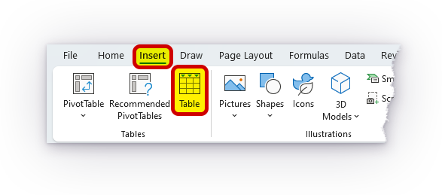
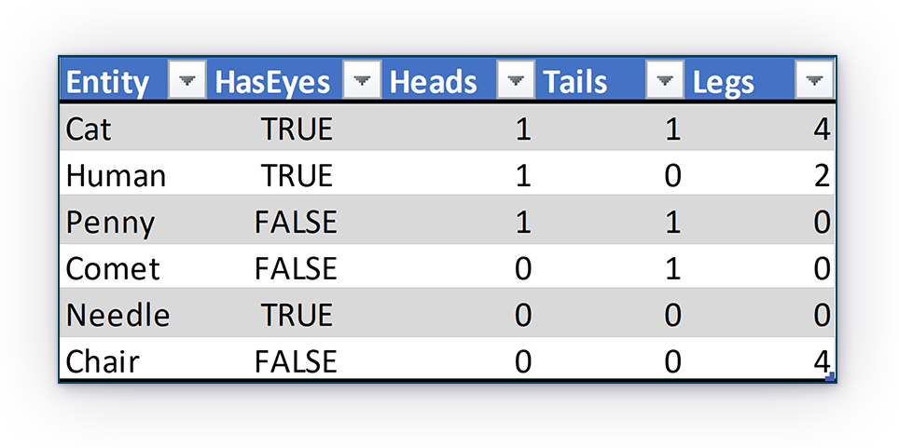
Excel Tables
In Excel, the Table is a convenient container for structured data.
Tables offer many useful functions, including:
Sorting and filtering.
Excel formula integration. Tables and Table columns can be referenced by name.
Dynamic referencing. Formula references to Table columns always point to the entire column, even when the Table changes size.
Notes:
Depending on the experience of the learners, the tutor may wish to deliver a short intro to Tables in Excel prior to moving learners on to the 'Basic Filtering' activity, which involves filtering a Table.

Slide 33
Filtering in Excel
Open file
'Learner Guide - Basic Filtering.pdf'
In this activity, we will learn how to apply various types of filter to an Excel Table, including:
text and numeric filters.
multi-column filters.
stacking filters via AND.

Slide 34
Filtering in Excel
Open file
'Learner Guide - Advanced Filtering.pdf' OPTIONAL
In this activity, we will learn how to work with Excel’s advanced filter commands, including:
defining the criteria range.
specifying criteria.
defining an advanced filter.
applying Unique, Sort, and Filter functions.
Notes:
This is an Optional Activity.
Name three elements of an advanced filter
AnsweAction; List range; Criteria; Copy to; Unique records only

Slide 35
Open file
'Learner Guide - Formulas and Functions.pdf'
FORMULAS AND FUNCTIONS in Excel
In this activity, we will learn how to work with Excel’s formulas and functions, including:
Data input.
Sorting data.
IF, COUNTIF, SUM IF.
AND, OR.
Conditional formatting.
VLOOKUP.
SUM, MAX, MIN.

Slide 36
Power query access
Check if you have the Power Query feature in your Excel.
Notes:
All learners to check if they have PQ using the ‘Get data’ option.
Assign VMs to those who don’t before finishing.

